Slide 1
LunchWith.ai
Conversation Structure
Setup and Usage of LunchWith.ai api

Slide 2
Story
Character - Steve
Background
Goals / Desires
Scene - Office
Setting
Role - Detective
Character - Molly
Background
Goals / Desires
Role - Client
Scene - Restaurant
Setting
CRUD Based HTTP API
Base api address: https://api.lunchwith.ai/
Setup - Create Assets to use in a conversation (this can be done once and reused every time a scene is run).
Scene - The main grouping of assets
Cast (scene dependent) - In a script, these are names associated with dialog
Character - Think of this as the actor that brings a specific personality to the role

Slide 3
Story
Character - Steve
Background
Goals / Desires
Scene - Office
Setting
Role - Detective
Character - Molly
Background
Goals / Desires
Role - Client
Scene - Restaurant
Setting
CRUD Based HTTP API
Base api address: https://api.lunchwith.ai/
Use - Create interactions and dialog. Reuse assets with every new scene / conversation.
Story - Manage Scenes and longer term interactions.
Scene - Take actions to configure the scene for use, process steps of the conversation.

Slide 4
Story
Character - Steve
Background
Goals / Desires
Scene - Office
Setting
Role - Detective
Character - Molly
Background
Goals / Desires
Role - Client
Scene - Restaurant
Setting
Story
This is a wrapper for multiple conversations. Think of it as a play with multiple scenes. The story structure allows data to persist across multiple scenes / conversations.

Slide 5
Story
Character - Steve
Background
Goals / Desires
Scene - Office
Setting
Role - Detective
Character - Molly
Background
Goals / Desires
Role - Client
Scene - Restaurant
Setting
Story Setup
GET /story
- List of active stories
DEL /story/{story_id}
- delete the story and allow no more scenes.

Slide 6
Story
Character - Steve
Background
Goals / Desires
Scene - Office
Setting
Role - Detective
Character - Molly
Background
Goals / Desires
Role - Client
Scene - Restaurant
Setting
Story Usage
To start a story, create a UUID4 and use it as {story_id}

Slide 7
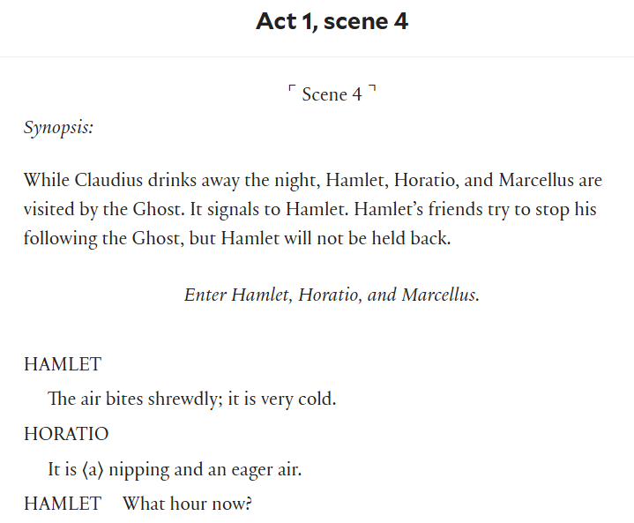
Story
Character - Steve
Background
Goals / Desires
Scene - Office
Setting
Role - Detective
Character - Molly
Background
Goals / Desires
Role - Client
Scene - Restaurant
Setting
Scene
This is like the scene of a play. It is a grouping that gives the cast members a chance to create dialog and interact. It creates the environment in which the characters interact and the direction the character needs to move (with respect to goals).

Slide 8
Story
Character - Steve
Background
Goals / Desires
Scene - Office
Setting
Role - Detective
Character - Molly
Background
Goals / Desires
Role - Client
Scene - Restaurant
Setting
Scene Data
"scene_id": "dc77a605-7060-49bc-8d14-7b35b0ade285",
"name": "The Detective's Office",
"description": "You are in an office with a desk covered with the sports page of the newspaper. There are two chairs on the other side of the desk and a filing cabinet in the corner. On top of the filing cabinet is an old coffee machine. If it wasn't raining so hard you would open a window. The rain should have cooled things down but it's still hot."

Slide 9
Story
Character - Steve
Background
Goals / Desires
Scene - Office
Setting
Role - Detective
Character - Molly
Background
Goals / Desires
Role - Client
Scene - Restaurant
Setting
Scene Setup
GET https://api.lunchwith.ai/scene
- List scenes in library
PUT/ https://api.lunchwith.ai/scene
POST / https://api.lunchwith.ai/scene/{scene_id}
- Add/update a scene in the library
DEL https://api.lunchwith.ai/scene/{scene_id}
- remove a scene from the library

Slide 10
Story
Character - Steve
Background
Goals / Desires
Scene - Office
Setting
Role - Detective
Character - Molly
Background
Goals / Desires
Role - Client
Scene - Restaurant
Setting
Story/Scene Use
POST /{story_id}/start_scene/{scene_id}
POST /{story_id}/finish_up
- Have the characters move towards the goal as quickly as possible
POST /{story_id}/end_scene
- End a scene

Slide 11
Story
Character - Steve
Background
Goals / Desires
Scene - Office
Setting
Role - Detective
Character - Molly
Background
Goals / Desires
Role - Client
Scene - Restaurant
Setting
Cast
Cast members are the ones listed in the script that have dialog.

Slide 12
Story
Character - Steve
Background
Goals / Desires
Scene - Office
Setting
Role - Detective
Character - Molly
Background
Goals / Desires
Role - Client
Scene - Restaurant
Setting
Cast Data
"cast_id": "dbc6e96a-ed9a-44c4-b44a-a117a2e85505",
“scene_id”: “11ac0383-8d97-4189-b7c3-4300f58dbfab”,
"role": "protagonist",
"goal": "Engage with the user meaningfully.",
"start": "The character enters and greets the user."

Slide 13
Story
Character - Steve
Background
Goals / Desires
Scene - Office
Setting
Role - Detective
Character - Molly
Background
Goals / Desires
Role - Client
Scene - Restaurant
Setting
Scene/Cast Setup (scene_id is required to work with cast)
GET https://api.lunchwith.ai/cast/{scene_id}
- List cast in library
PUT/ https://api.lunchwith.ai/cast/{scene_id}
POST / https://api.lunchwith.ai/cast/{scene_id}/{cast_id}
- Add/update a scene to the library
DEL https://api.lunchwith.ai/cast/{scene_id}/{cast_id}
- remove a scene from the library

Slide 14
Story
Character - Steve
Background
Goals / Desires
Scene - Office
Setting
Role - Detective
Character - Molly
Background
Goals / Desires
Role - Client
Scene - Restaurant
Setting
Scene/Cast Usage
POST /{story_id}/summarize/{cast_id}
- Flag this cast member as needing a summary of this scene. If the cast member will be used in the future this will allow the cast member to remember what happened. This needs to happen before the scene is ended.

Slide 15
Story
Character - Steve
Background
Goals / Desires
Scene - Office
Setting
Role - Detective
Character - Molly
Background
Goals / Desires
Role - Client
Scene - Restaurant
Setting
Scene/Cast Usage - Dialog
POST /story/{story_id}/get_response_step/{cast_id}
- What does this cast member say? This will generate a response and add a line to the conversation within the context of the current scene.
POST /story/{story_id}/post_response/{cast_id}
- If you have a response, like one received from a user in a chat, this will add that text as a line in the conversation within the context of the current scene.

Slide 16
Story
Character - Steve
Background
Goals / Desires
Scene - Office
Setting
Role - Detective
Character - Molly
Background
Goals / Desires
Role - Client
Scene - Restaurant
Setting
Character
There have been many different interpretations of Hamlet, with the main character played by David Tennant, Kenneth Branagh, and Sir Laurence Olivier. Each actor brings a different flavor to the role.

Slide 17
Story
Character - Steve
Background
Goals / Desires
Scene - Office
Setting
Role - Detective
Character - Molly
Background
Goals / Desires
Role - Client
Scene - Restaurant
Setting
Character Data
"character_id": "dbc6e96a-ed9a-44c4-b44a-a117a2e85505",
“name”: “Steve Lugar”,
"description": "You are a Private Detective straight out of a classic film noir or detective novel. You have walked these mean streets for a decade and have learned how to ask good questions and observer people's behavior. ",
"motivation": "You are down on your luck and willing to take any job that comes your way. No matter how much you need a job you won't tangle with the mob.",

Slide 18
Story
Character - Steve
Background
Goals / Desires
Scene - Office
Setting
Role - Detective
Character - Molly
Background
Goals / Desires
Role - Client
Scene - Restaurant
Setting
Character Setup
GET https://api.lunchwith.ai/character/
- List characters in library
PUT/ https://api.lunchwith.ai/character/
POST / https://api.lunchwith.ai/character/{character_id}
- Add/update a character in the library
DEL https://api.lunchwith.ai/character/{character_id}
- remove a character from the library

Slide 19
Story
Character - Steve
Background
Goals / Desires
Scene - Office
Setting
Role - Detective
Character - Molly
Background
Goals / Desires
Role - Client
Scene - Restaurant
Setting
Story/Cast/Character Usage
POST /{story_id}/cast/{characer_id}/as/{cast_id}
- Tie the character to a specific role. The character’s personality will direct the interactions in the scene. This is to be used with an active scene.

Slide 20
Story
Character - Steve
Background
Goals / Desires
Scene - Office
Setting
Role - Detective
Character - Molly
Background
Goals / Desires
Role - Client
Augment
Additional info
Augment
There are times when you need to add additional information to a cast_id. This is usually background information (such as which tarot card was turned) or updated information (Buddy hears something on the shore in the middle of a conversation).

Slide 21
Story
Character - Steve
Background
Goals / Desires
Scene - Office
Setting
Role - Detective
Character - Molly
Background
Goals / Desires
Role - Client
Augment
Additional info
Augment Data
“augment”: “You hear a noise in the forest…”,

Slide 22
Story
Character - Steve
Background
Goals / Desires
Scene - Office
Setting
Role - Detective
Character - Molly
Background
Goals / Desires
Role - Client
Augment
Additional info
Augment Usage
POST /story/{story_id}/augment/{cast_id}
- Add the augment to a specific cast member in the active scene. Pass ‘augment’ text as the data. Like setting summaries, this happens only when a scene has been started.

